Slide 1


Slide 2
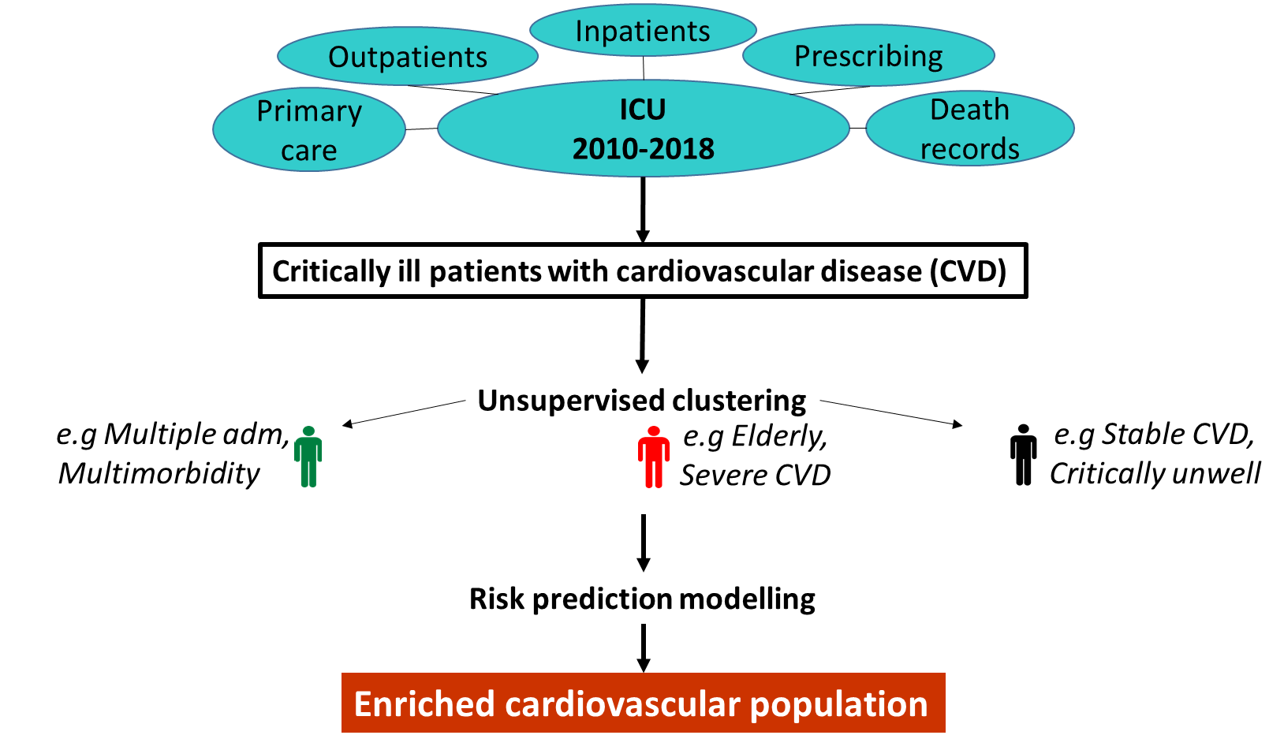
HYPOTHESIS: CURRENT TRIAL DESIGN PREVENTS ADVANCES IN ICU RESEARCH
PHASE 1:
Characterise CVD Population
PHASE 2:
Identify high risk groups

Slide 3




Trial: Liberal vs Restrictive transfusion thresholds in critically ill patients with CVD
Restrictive (“Control”)
Liberal
PHASE 1 & 2:
Enriched CV population
PHASE 3: Intermediate outcome
“Vital signs data”
Liberal better than restrictive
Liberal worse than restrictive
PHASE 4:
Adaptive enrichment
profiles benefit from liberal
Primary
outcome

Slide 4
Intensive Care
1-to-1 nursing
Sickest patients in the hospital
RIE:
18 ICU beds, 10 HDU beds. Soon to expand to 40
Tertiary liver and trauma service (and neurosurgery)
2018: 1,296 admissions (Scotland 15,720)

Slide 5


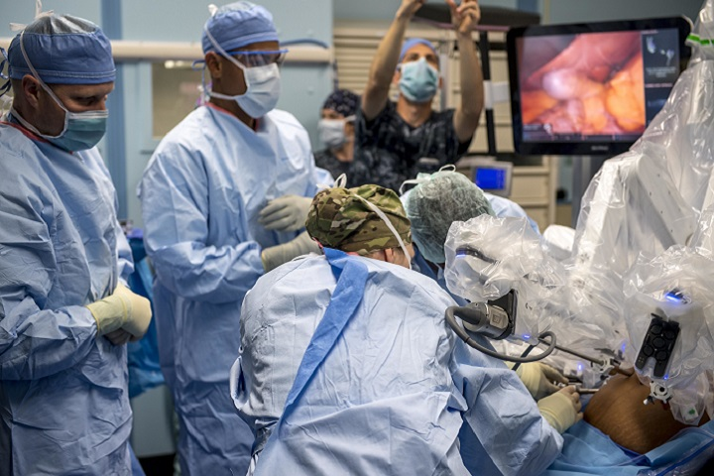
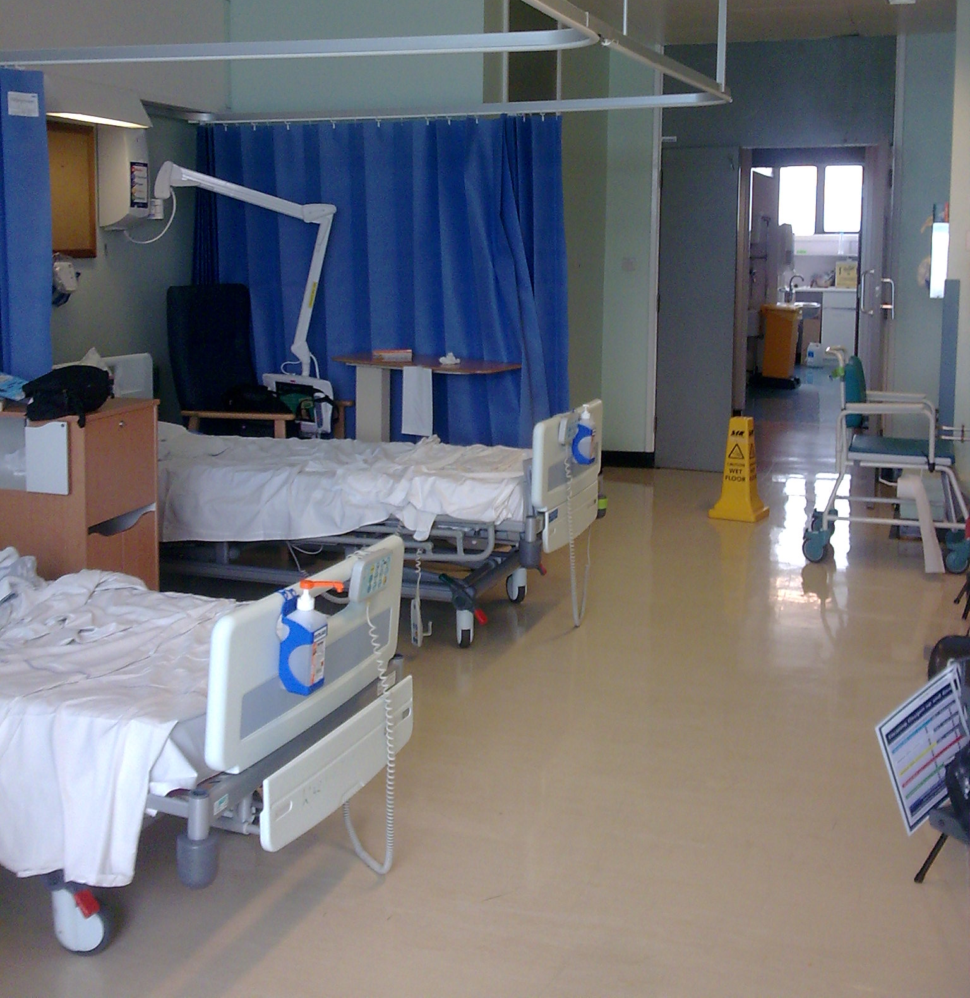
Type of admissions
Median age 57
Male 56%
23%
Source of admission
47%
23%
7%

Slide 6
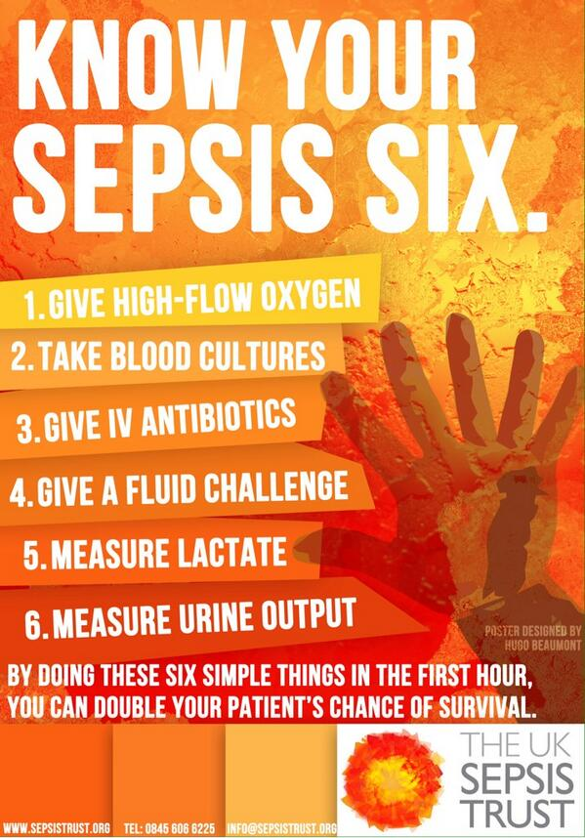
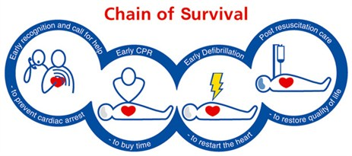

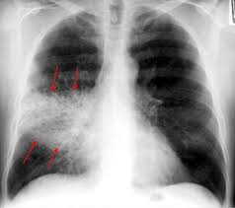
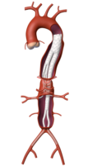

Type of admission
EMERGENCY
ELECTIVE
Notes:
Elective surgery
General surgery
Vascular
Orthopaedics

Slide 7

Interventions
Reduce brain pressure
Ventilator
Intravenous nutrition
Blood pressure support
Liver transplant
Extra-corporeal
Membrane oxygenation
Renal replacement therapy

Slide 8
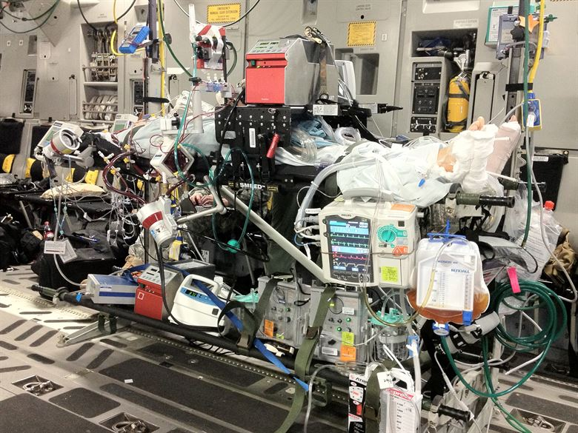

Slide 9
Outcomes
Length of stay in ICU 2.7 days
Invasive ventilation 57%
Blood pressure support 50%
Renal replacement therapy 8%
Hospital mortality: 18%

Slide 10
Myocardial Injury in Critically Ill patients with Cardiovascular Disease:
Cardiovascular disease:
Ischaemic Heart Disease
Cerebrovascular Disease
Peripheral Vascular Disease
Risk factors: age >75 with diabetes/hypertension
7 million people in UK
2nd commonest cause of death
Approx 25% adult ICU patients
Notes:
CVD includes all diseases affecting the heart and blood vessels. Approximately seven million people in the UK have co-existing CVD (4, 5); it is the second commonest cause of death in the UK, accounting for 27% of all deaths, 25% of premature deaths in men, and 17% of premature deaths in women. Approximately 25% of adult intensive care unit (ICU) admissions have pre-existing cardiovascular disease (CVD) (6, 7), but most are admitted with unrelated conditions. Approximately 217,000 patients were treated in adult UK critical care units (ICUs and HDUs) in 2015-2016, equivalent to around 54,000 patients with CVD per year.

Slide 11
Problems with CVD in ICU
Heart unable to compensate
Fast heart rate, low blood pressure
Plaques in coronary arteries, reduce blood supply to heart
Low haemoglobin levels (anaemia) cause low oxygen delivery
Notes:
Patients with CVD have impaired compensatory ability to respond to the increased generalised and myocardial oxygen demands that occur during critical illness, which places stress on the heart (8). This is exacerbated by tachycardia and hypotension, which reduces coronary artery blood flow, and catecholamines which increase myocardial oxygen demand. The myocardium is sensitive to reduced oxygen supply, because it extracts 75% of the oxygen supplied by the coronary arteries even at rest, resulting in a very low coronary sinus PO2 (3kPa). Atheroma-related flow limitation is therefore a major threat to myocardial oxygen delivery, especially during physiological stress. In critical illness this is further complicated by acute onset moderate to severe anaemia (haemoglobin concentration <90g/l) in 40–50% of ICU patients (8), which reduces coronary artery oxygen conten

Slide 12
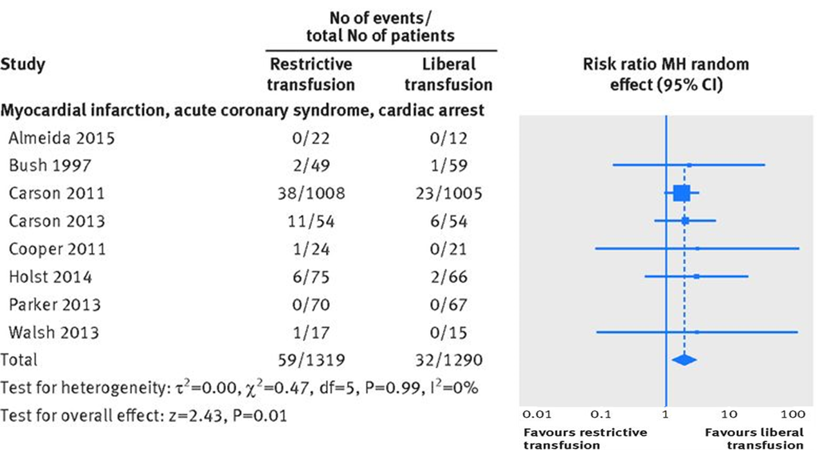
Acute Coronary Syndrome: Blood transfusion
RR 1.78, 95%CI 1.18 to 2.70
Favouring liberal threshold
Docherty et al,
BMJ March 2016

Slide 14
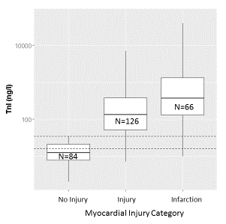
TROPICCAL cohort study n=279
30%
46%
24%
10,000
Clinically diagnosed MI
12 (4%)
TnI (ng/l)
3 fulfilled definition (1%)
100
No Injury
Injury
Infarction
Docherty et al, Intensive Care Med, 2018

Slide 15
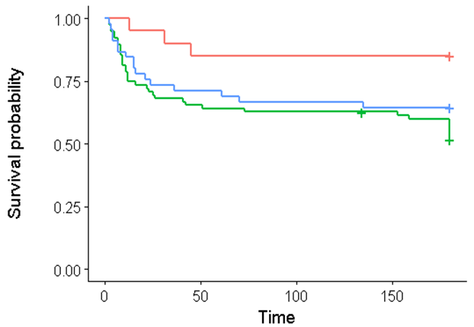
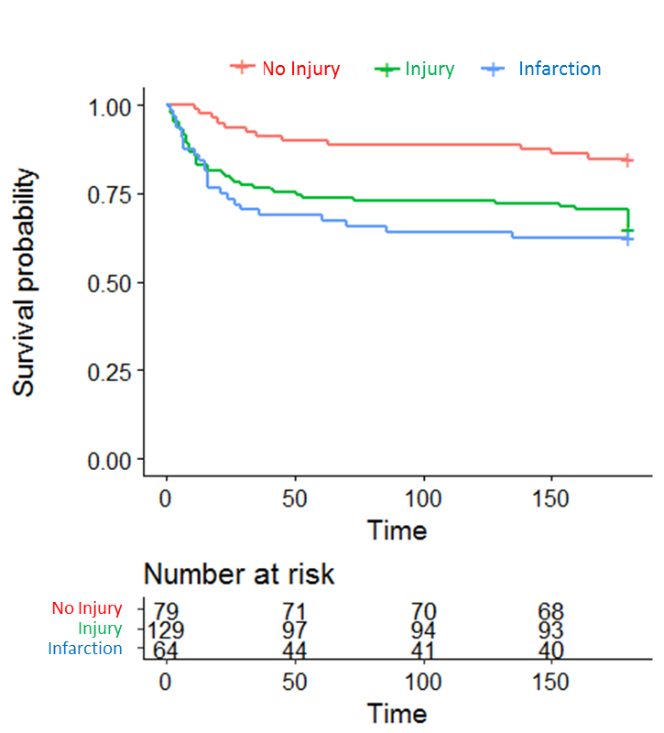
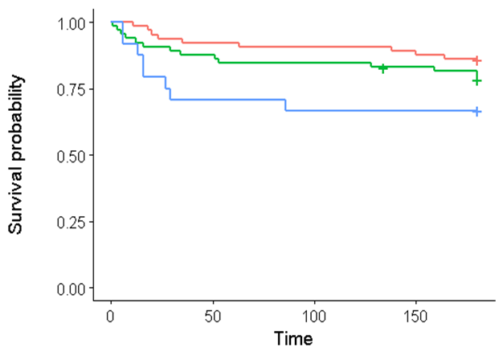
6 month mortality
Most critically
unwell
Less critically
unwell
Log rank test p=0.003
Persistent high
mortality
Notes:
mortality attributable to new MI may be proportionately greater in patients with less severe illness.

Slide 16
TROPICCAL 6 month mortality: Mediation analysis
Exposure
Mediator
Outcome
P=0.002
6m mortality
Illness severity
Direct: 63%
Indirect: 37%
MI
Co-variates: age, sex, comorbidity, admission type, diagnosis

Slide 17
Conclusions
True incidence of heart attacks 24%
>95% not diagnosed clinically
Significant association with mortality
On the causal pathway to mortality
Potentially modifiable

Slide 18
Data sources

Slide 19


DATA SOURCES: ROUTINE HEALTHCARE DATA
SMR01
Inpatients
HES inpatients
SMR00 outpatients
Prescribing data
HES outpatients
Death registrations
Primary care
135,000 critically ill patients
SICSAG 2010-2018
Death records
1.8 million critically ill patients
ICNARC 2010-2018
34,000 Critically ill patients with CVD
540,000 Critically ill patients with CVD
Unsupervised clustering
Unsupervised clustering
Seymour 2019
Risk prediction modelling
Validation
Risk prediction modelling
Enriched cardiovascular population
Notes:
Consensus k means clustering

Slide 20
Type of data
Tabular, coded data
Collected routinely
Linked by CHI (Community Health Index)
Pseudonymised
Analyse within eDRIS
university desktop
Bring your own programme: R and python supported
Needs approval PBPP approval (Public Benefit and Privacy Panel)
Demographics
Pre-existing health indices
Information relating to acute/critical illness
Subsequent hospital readmissions, cardiovascular events, mortality
Accuracy rates SMR01 2010-2011: 88% for the Main Condition
Notes:
age, sex, socioeconomic status
comorbidity and frequency of hospital admissions
Outcome data will be extracted for a two year period after
the index ICU admission and will include: all-cause mortality, cardiac mortality, cardiac events, healthcare resource use, readmissions, and health trajectories.

Slide 21
Identify patient phenotypes

Slide 22
Unsupervised clustering techniques
Clinical phenotypes for sepsis Seymour JAMA 2019
Consensus k means clustering
Latent class analysis
Classification of Acute decompensated heart failure Ahmad PLOS ONE 2016
Hierarchical cluster analysis
COPD phenotypes Burgel European Respiratory Journal 2010
Principal component analysis
Parkinsons phenotypes Errol PLOS ONE 2013
K-means

Slide 23
Neural networks
MIMIC-III dataset:
Medical Information Mart for Intensive Care III
De-identified ICU patients 2001-2012 Beth Israel Deaconess Medical Centre
Predicting sepsis with a recurrent neural network
Scherpf 2019
An attention based deep learning model of clinical events in the intensive care unit
Kaji PLOS One 2019

Slide 24
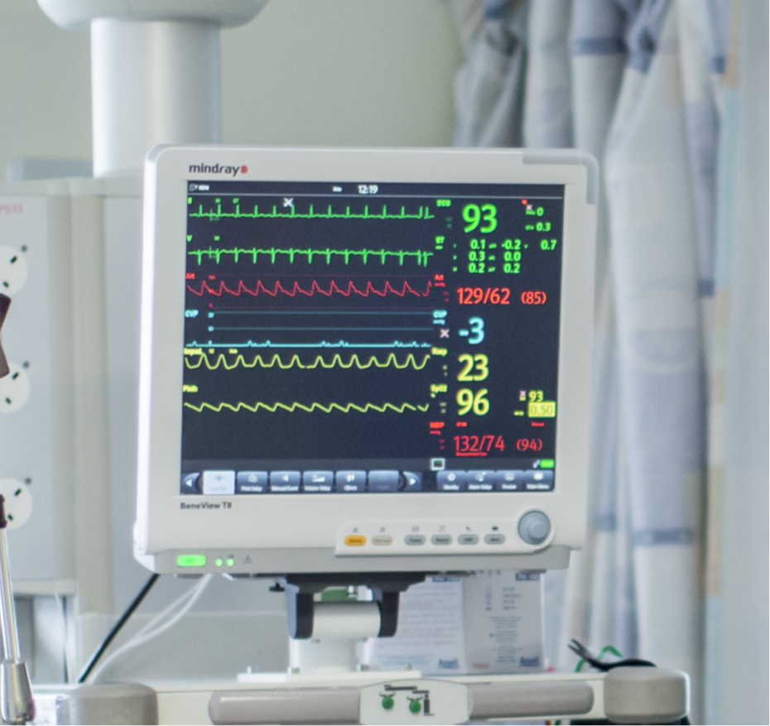
DATA SOURCES: ROUTINE VITAL SIGNS DATA
ECG analysis
Ischaemia
arrhythmia
Heart rate
Blood pressure
Oxygen saturations
Respiratory rate

Slide 25
Biomedical signal processing
CHART-ADAPT:
Anonymised data from Neuro ICU in Glasgow
Down sampling of high frequency patient data
Inform clinical decision making
ECG beat detector
Arterial blood pressure beat detector
Respiratory rate estimation

Slide 26
4 file formats
CSV files with full numerical and waveform data
numerical parameters recorded in CSV files at 1-second intervals
graphical plots of all waveform data in a range of resolutions as PNG image file
graphical overview plots of numerical data for entire cases as PNG and SVG files

Slide 27
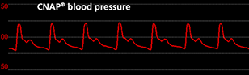
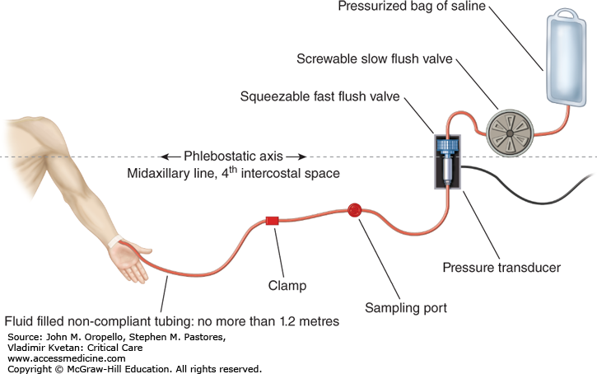

Difficult data
Artefact
Disconnection
Blood sampling
Transducer falling on floor
Damped trace

Slide 28
Difficult data
High volume
50 Hz for 3-5 days
Where to store it
Approvals
De-identified datasets: MIMIC III, Physiobank, IMPROVE
NHS datasets
Firewall
Approvals
Link with longer term outcomes

Slide 29
Conclusion
Complex real-life data
Routinely collected, already exists
Opportunities for collaboration between clinicians and data scientists
Improve outcomes for critically ill patients with co-existing cardiovascular disease

